Slide 1
PACEE
LIAN Xiaogang 连晓刚

Slide 2
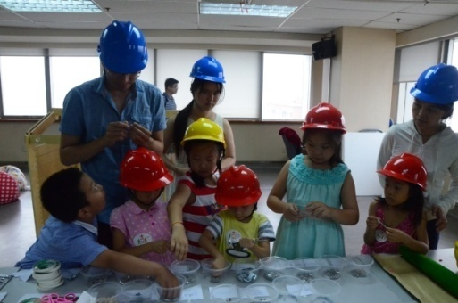
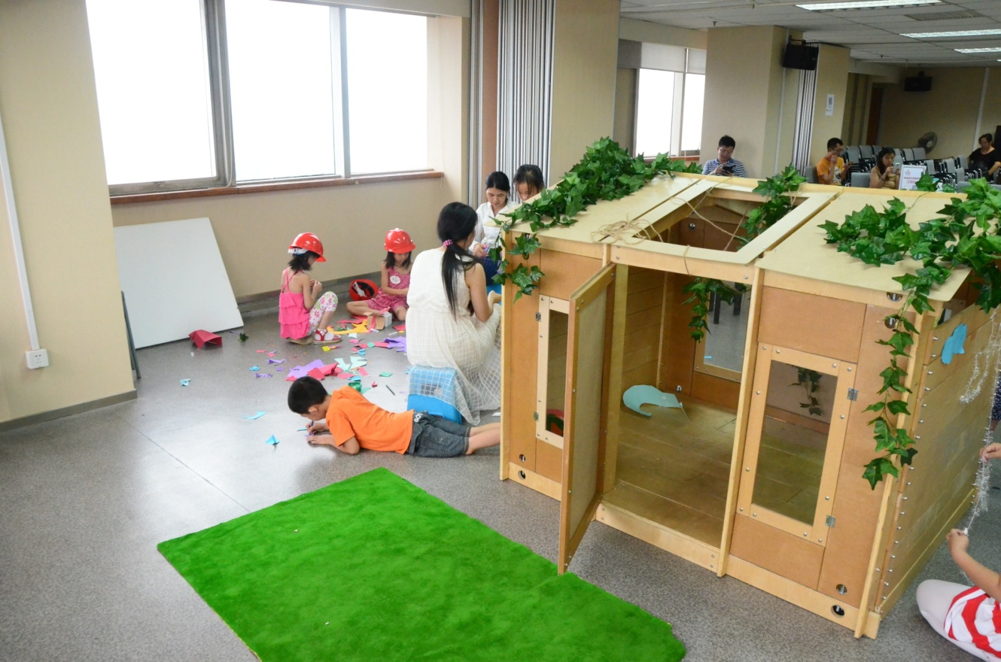
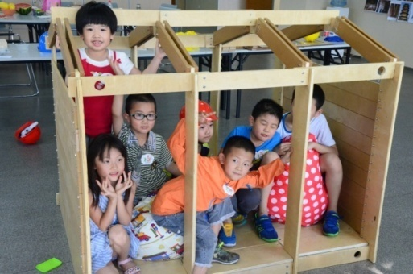
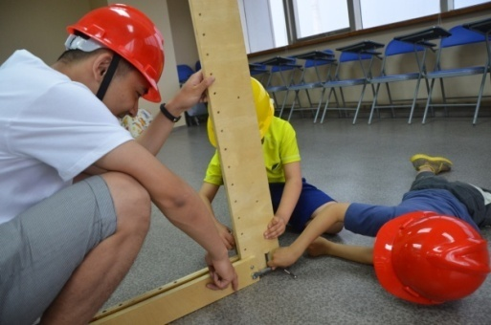
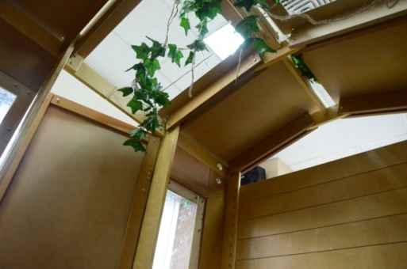
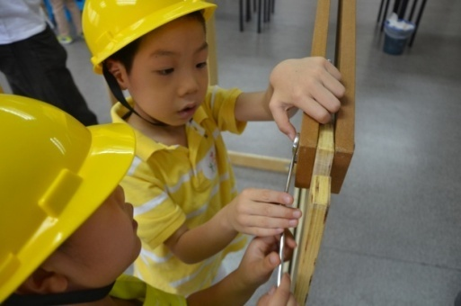
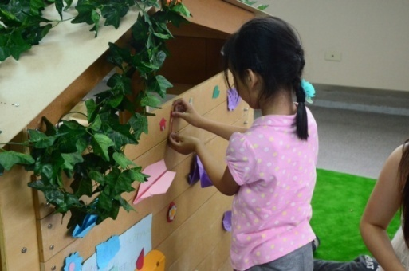
Wood Workshop

Slide 3
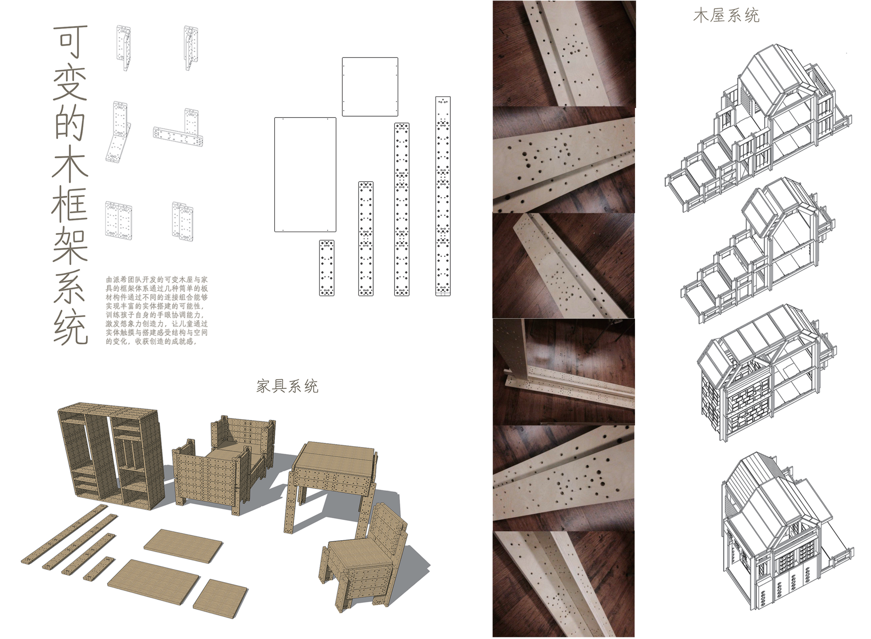

Slide 4
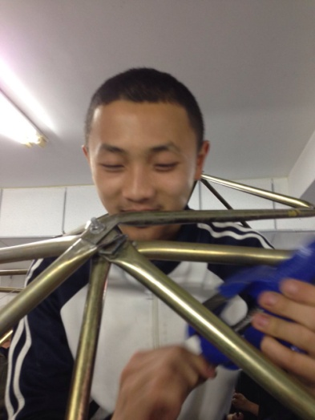
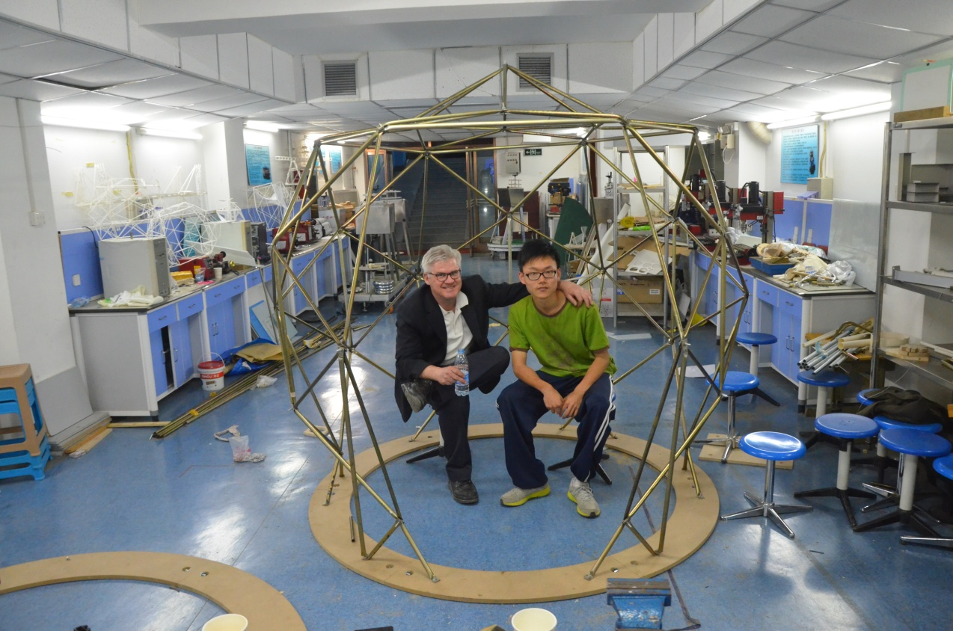
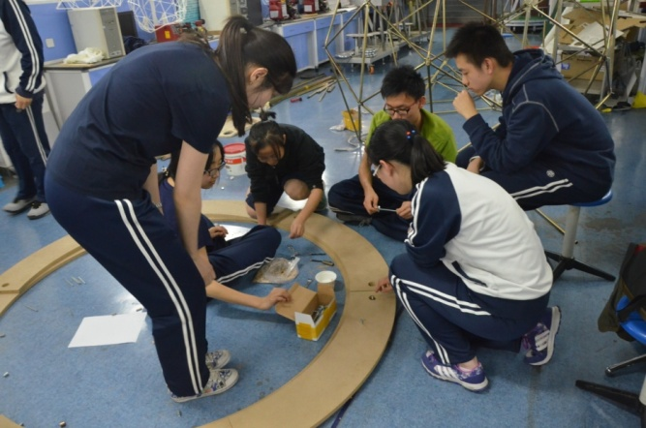
Metal Pipes Workshop

Slide 5
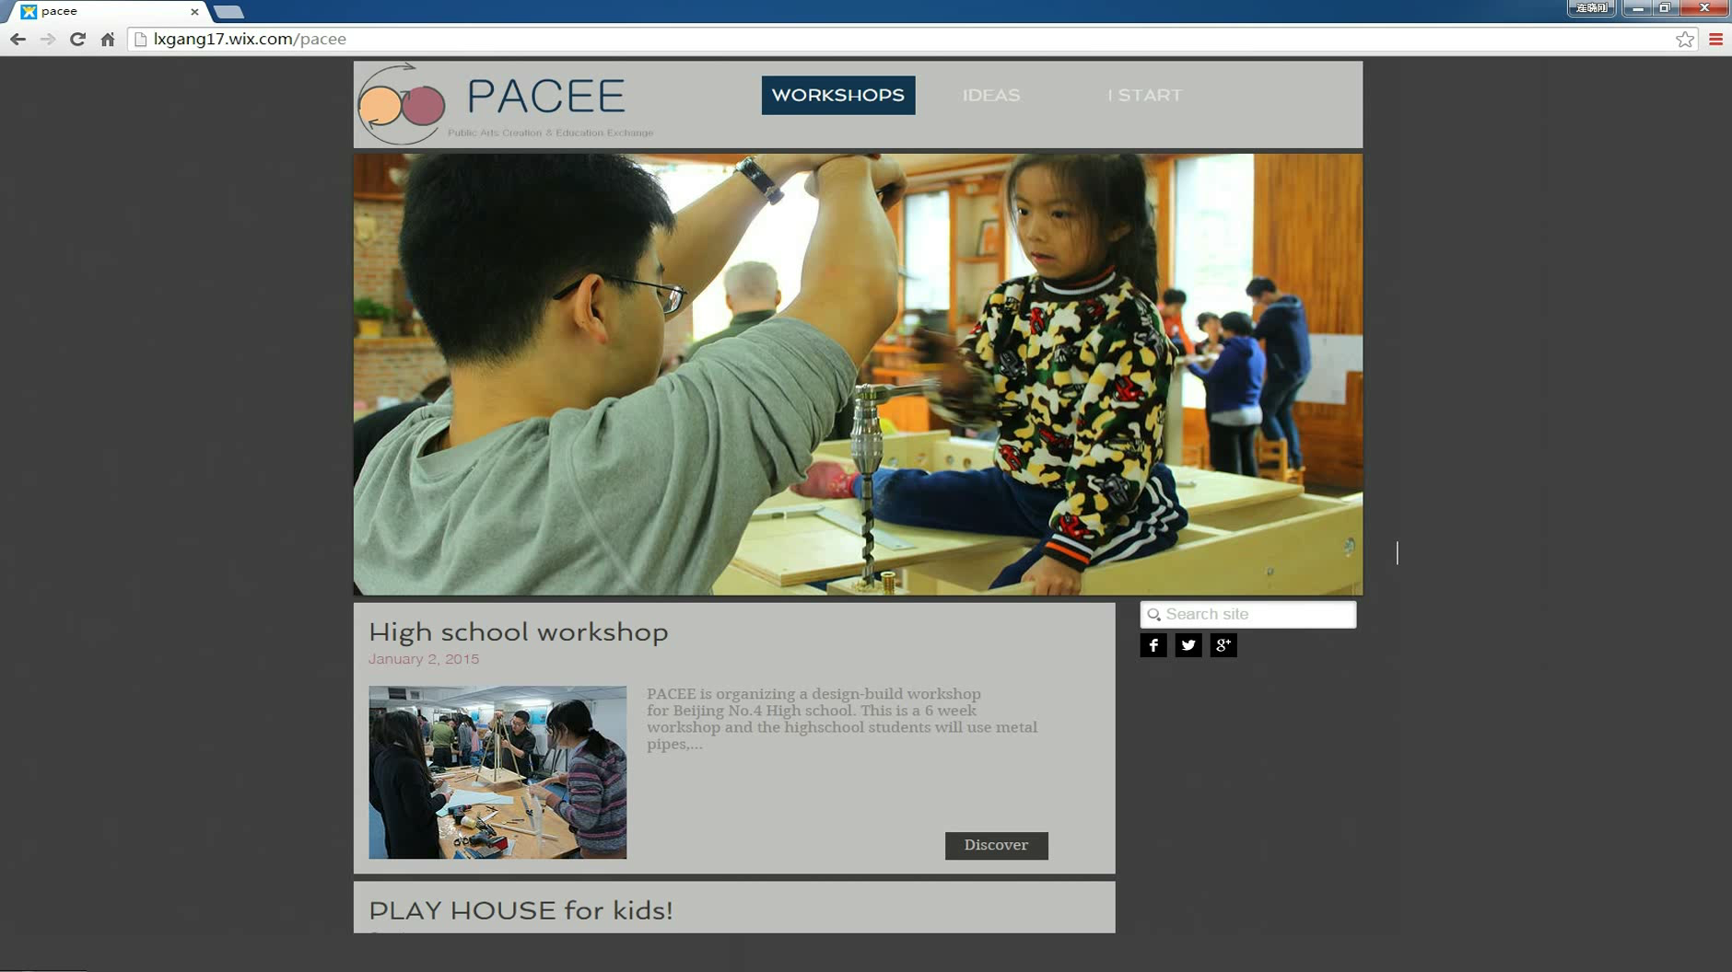
w

Slide 6
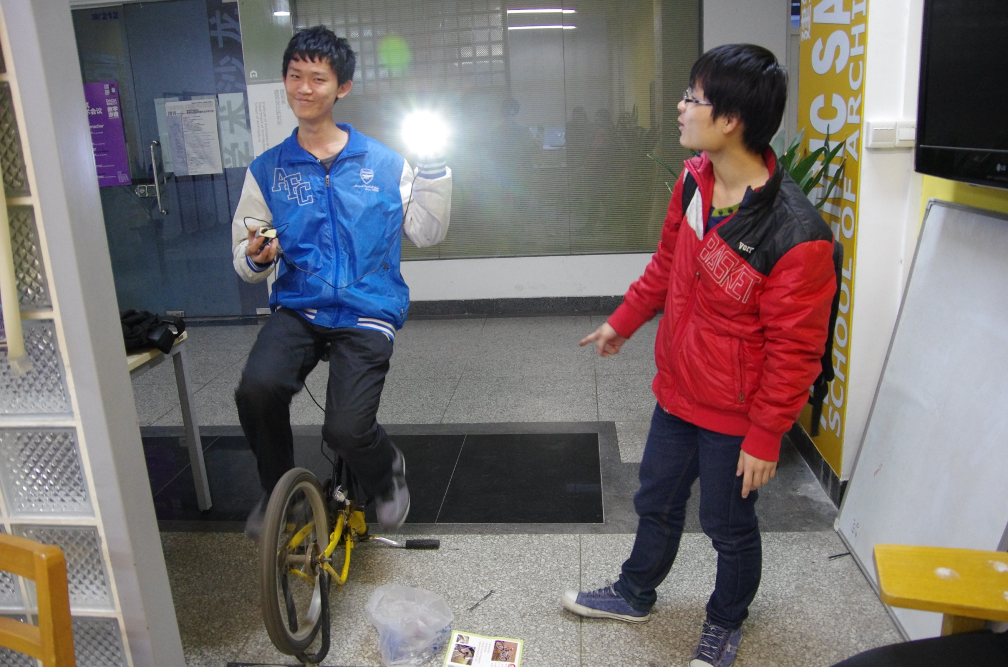
Recycled Bicycle

Slide 7






Value Creation Workflow
Coordination
Generate
Idea
Resource Planning
Product
Dev.
Market Release
Our Plan
Wiki Websites for
Learning Process
Data Collection
Knowledge Repositories for individuals and for community
Toyhouse
+
Our Vision
Free Software, Free Society
Free Resource for Free Learning

